Slide 1
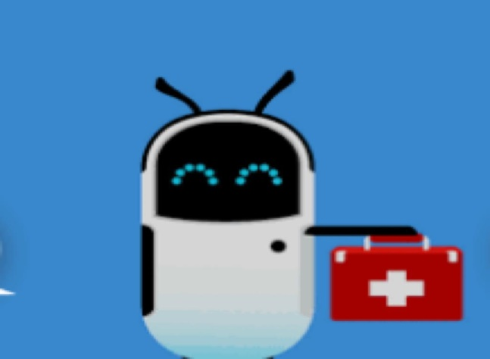
BOT AID
-A Chatbot for Hospital Management

Slide 2

TEAM MEMBERS:
Batch 3 (IT-1)
A.Lahari 18071A1203
B.Aparna 18071A1208
N.Chandana 18071A1243
T.Rajeshwar 18071A1253
Guide:
Dr.D.Srinivasa Rao,
Associate Professor,
(HoD-Information Technology)

Slide 3
Overview:
Abstract
Introduction
UML Diagrams
Algorithms
Methodology
Project Structure
Datasets
Technologies Used
Dataset
Output
Results

Slide 4
Abstract:
This project focuses on creating a chatbot that can be used by anyone to get their queries responded easily for the hospital related queries. This chatbot is capable of providing information for general queries thereby saving time and making friendly conversations without any hesitation.

Slide 5
Introduction:
A chatbot is a computer program designed to simulate conversation with human users, especially over the internet.
Our project is to implement a health care chatbot to answer user queries and guide them accordingly.

Slide 6
Why we need Chatbots?
Cost and Time Effective ~ Humans cannot be active on-site 24/7 but chatbots can and the replying power of chatbots is much fast than humans.
Cheap Development cost ~ with the advancement in technology many tools are developed that help easy development and integration of chatbots with little investment.
Human Resource ~ Today Chatbots can also talk with text o speech technology so it gives the feel as a human is talking on another side.
Business Branding ~ Businesses are changing with technology and chatbot is one out of them. Chatbot also helps in advertising, branding of organization product and services and give daily updates to users.

Slide 7
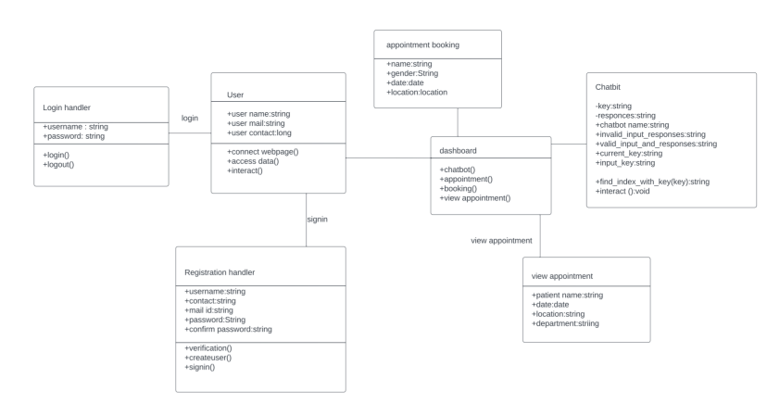
UML DIAGRAMS CLASS DIAGRAM:

Slide 8
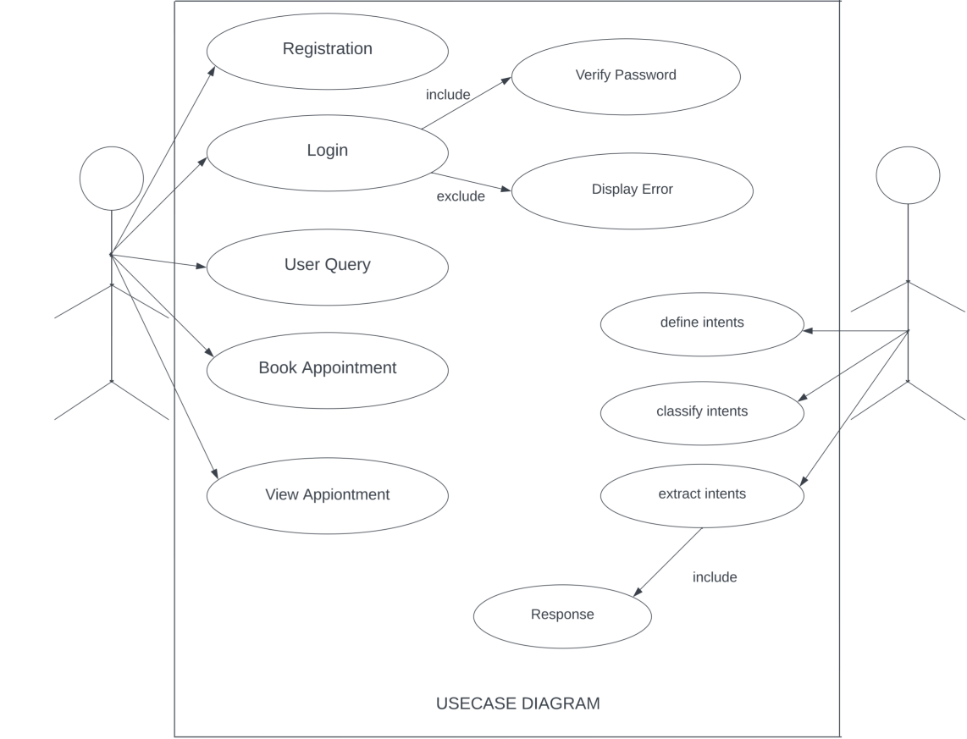
USECASE DIAGRAM:

Slide 9
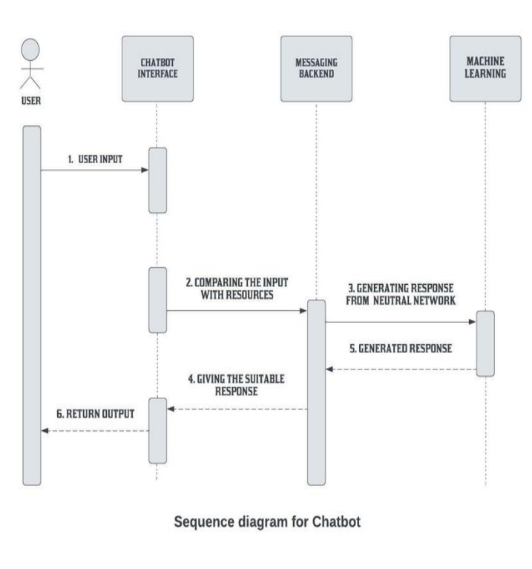
SEQUENCE DIAGRAM:

Slide 10
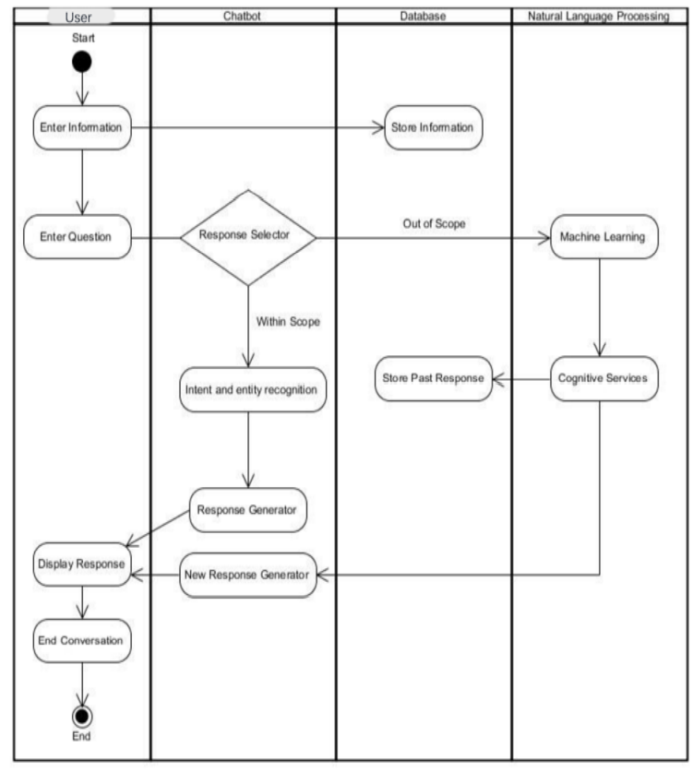
ACTIVITY DIAGRAM:

Slide 11
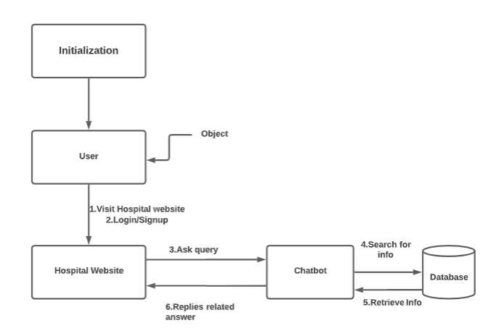
OBJECT DIAGRAM:

Slide 12
Algorithm: 1.The Sequence to Sequence Model(seq2seq):
In Sequence to Sequence Model(seq2seq ) model the model takes input as sequence of words or sentences and then generates an output which is sequence of words.This is done with the help of recurrent neural network (RNN).
Input to this model is token of words and the output of this model is the translated token of words.
This model takes the current word or input along with the neighbouring words while translating it into output.
As seq2seq model mainly has two components namely Encoder and Decoder so this model is also called as the Encoder-Decoder Network.

Slide 13
Role of Encoder:
The main motive of the encoder is to capture the context of the input sequence in the form of a hidden state vector and then the encoder feeds it to the decoder which at the last produces the output sequence.It takes the sequence of words as an input and generates a final embedding words at the end of the sequence with the help of RNNs.This final embedding sequence of words is then sent to the Decoder.
Role of Decoder:
The input to decoder is the hidden vector which is generated and fed by Encoder. The decoder reverses the process of Encoder. It turns the hidden state vector fed by the encoder into an output sequence of words. It uses the previous output as the input context for doing this. It also uses its own hidden states and current word to predict the next word.

Slide 14
2.LSTM
Long Short Term Memory is a kind of recurrent neural network. In RNN output from the last step is fed as input in the current step.
It tackled the problem of long-term dependencies of RNN in which the RNN cannot predict the word stored in the long-term memory but can give more accurate predictions from the recent information.
As the gap length increases RNN does not give an efficient performance. LSTM can by default retain the information for a long period of time. It is used for processing, predicting, and classifying on the basis of time-series data.

Slide 15
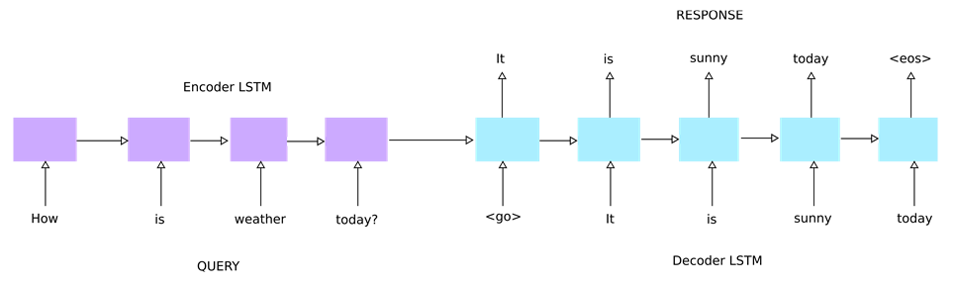
LSTM Architecture:

Slide 16
Methodology:
The Chatbot works based on DNN(Deep Neural Network) to identify the patterns of sentences given by the user as input and pick a random response related to that query.
We Build a chatbot using deep learning techniques. The chatbot will be trained on the dataset which contains categories (intents), pattern and responses.
We use a special recurrent neural network (LSTM) to classify which category the user’s message belongs to and then we will give a random response from the list of responses.

Slide 17
The NLTK Library in Python has functions that help to figure out the most relevant words from a sentence or paragraph and stem the words into their root meaning and can reduce them,(for instance, the root meaning or stem of the word 'going' is 'go'). This process is known as Stemming.
The words are then converted into their corresponding numerical values since the Neural Networks only understand numbers. The process of converting text into numerical values is known as One-Hot Encoding.
When the data preprocessing is completed we'll create Neural Networks and then fit the training data into it. After the successful training, the model is able to predict the tags that are related to the user's query.

Slide 18
Steps Involved:
Import and load the data file
Pre-processing data
Create training and testing data
Build the model (we will build a deep neural network that has 3layers. We use the Keras sequential API for this)
We will train our model for number of epochs to improve the accuracy

Slide 19
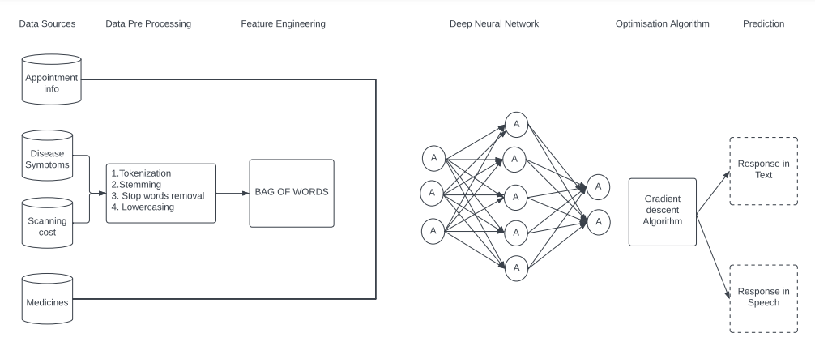
Workflow of the model:

Slide 20
Project Structure(folders) :
Below are the folders that our project will consist:
Intents.json – The data file which has predefined patterns and responses
chatbot.ipynb – In this Python file, we wrote a script to build the model and train our chatbot.
Words.pkl – This is a pickle file in which we store the words Python object that contains a list of our vocabulary.
Classes.pkl – The classes pickle file contains the list of categories.
chatbot_model.h5 – This is the trained model that contains information about the model and has weights of the neurons.
gui.py – This is the Python script in which we implemented GUI for our chatbot. Users can easily interact with the bot.

Slide 21
Technologies Used:
Machine Learning and Deep Learning
NLP and RNN Algorithms
Python Libraries
Flask(web development for front end)
Google Colab

Slide 22
Data collection:
Real time hospital data will be collected in JSON format
All the required attributes are present in the dataset
Algorithms are applied,patterns are found and responses are given to users.
Chatbot is highly customizable and we can make changes as we want when it comes to training data.

Slide 23
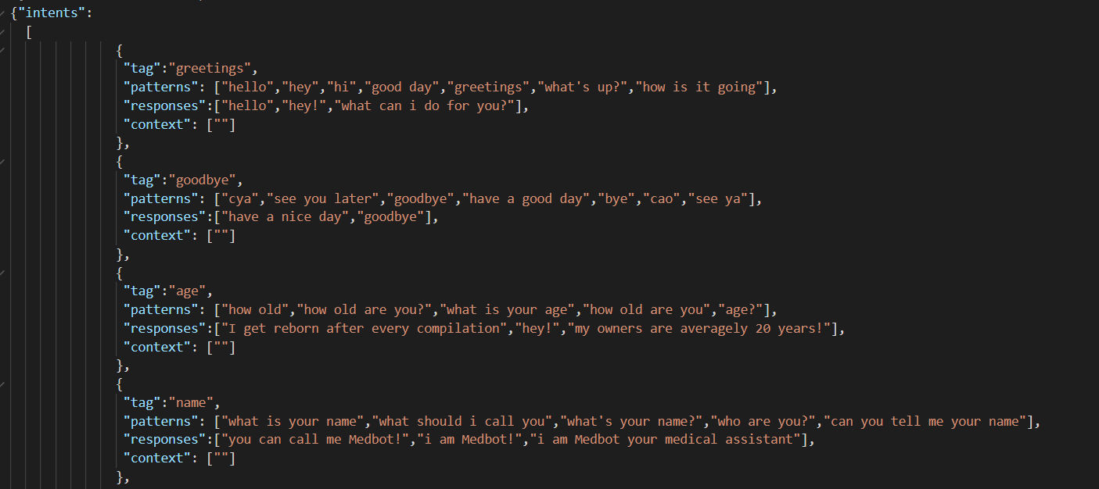
Sample DataSet:
General Data(Greetings):

Slide 24
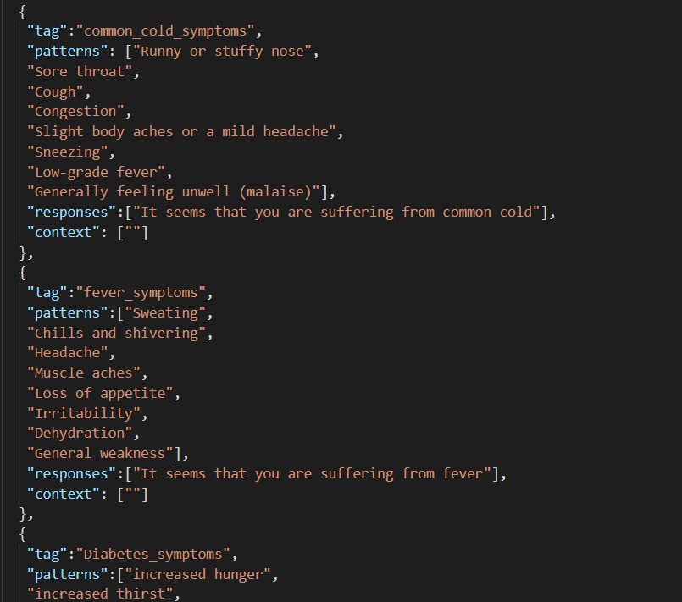
Data on Health problems and symptoms

Slide 25
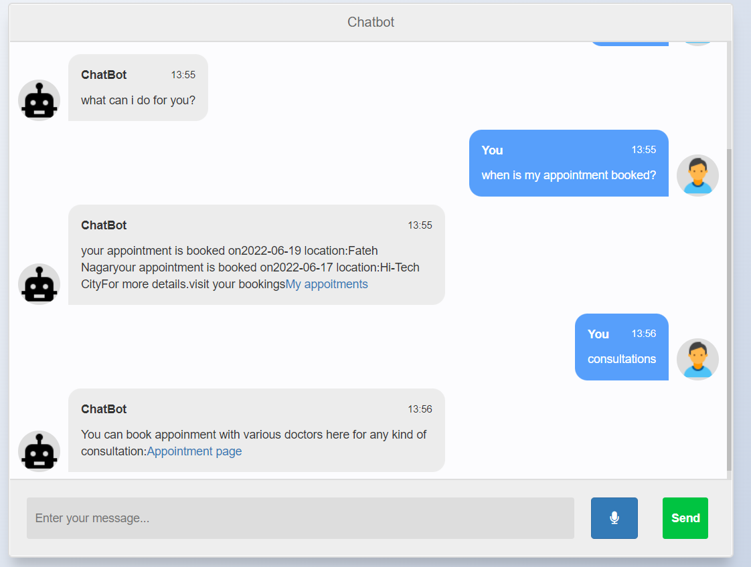
WEB BASED CHATBOT USING FLASK:

Slide 26
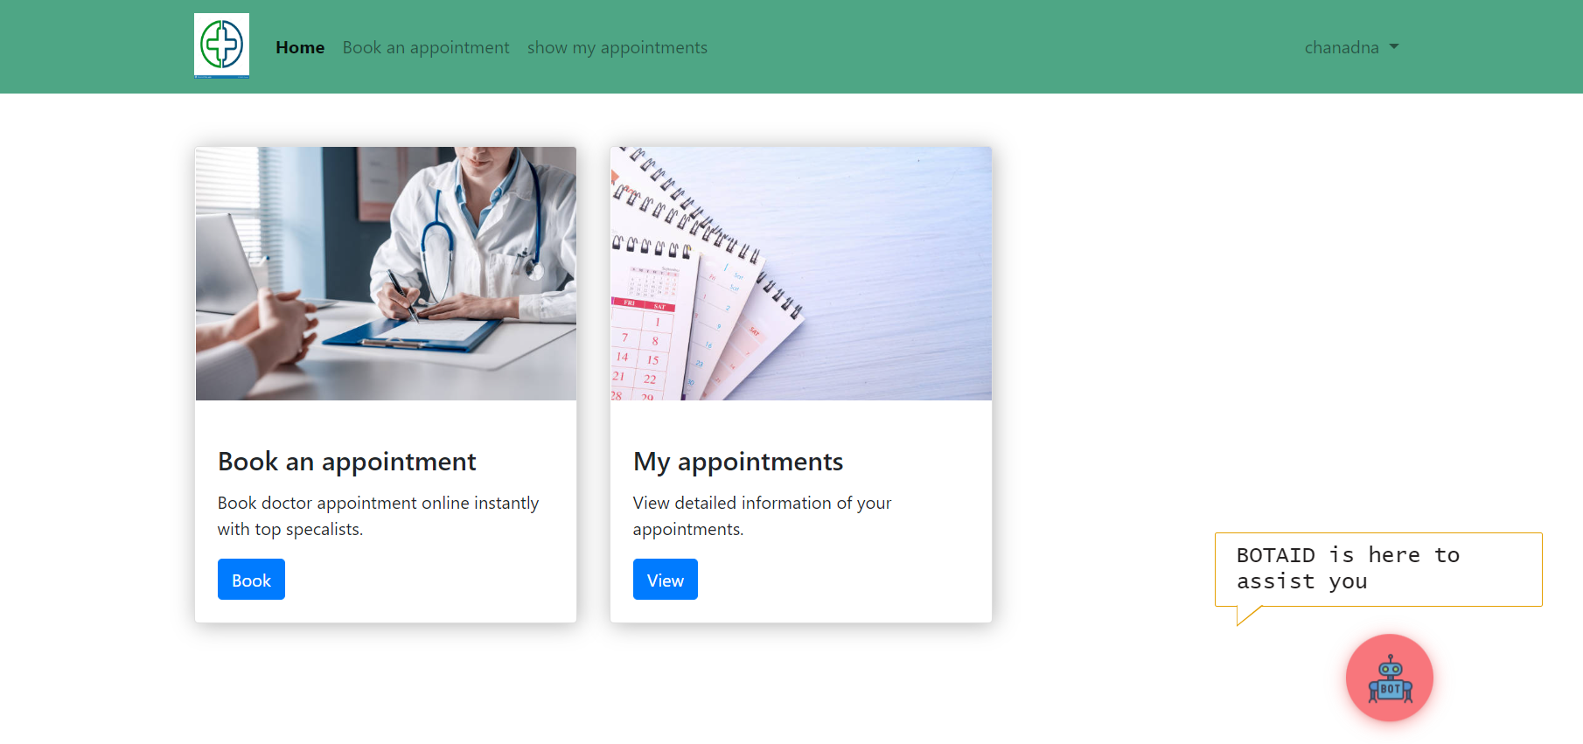
DASHBOARD PAGE:

Slide 27
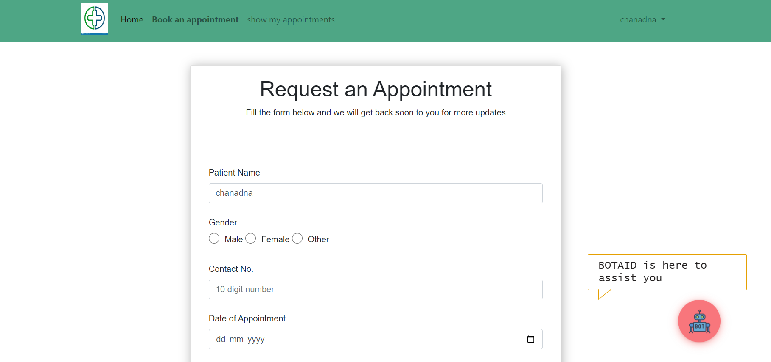
APPOINTMENT PAGE:

Slide 28
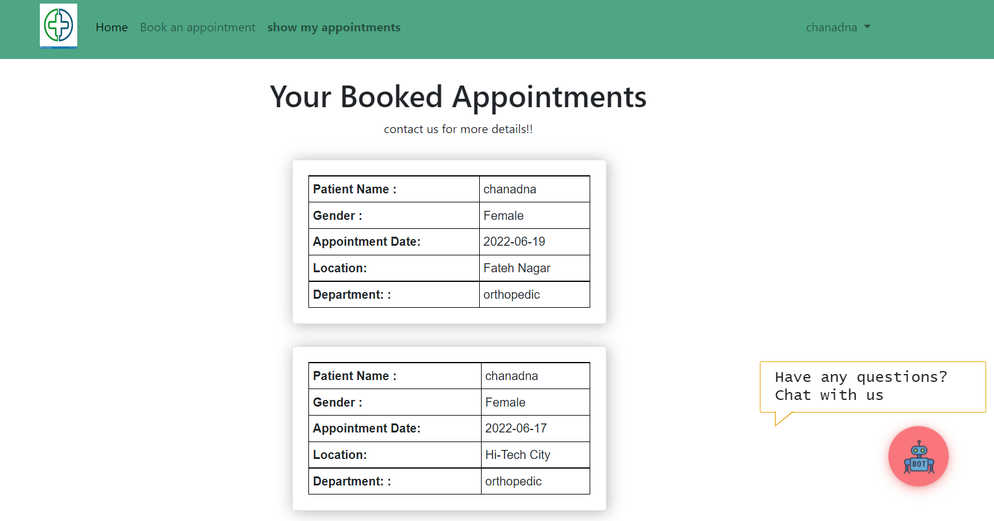
BOOKED APPOINTMENTS PAGE:

Slide 29
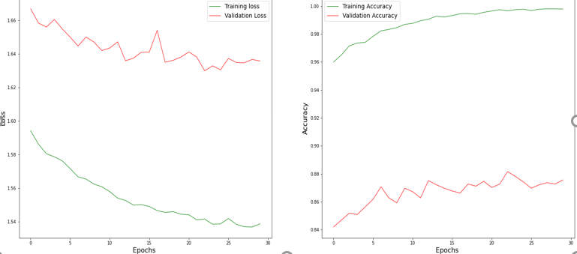
RESULTS:
Accuracy: 94.52%

Slide 30
References:
https://www.sciencedirect.com/science/article/pii/S1658361221001293
http://www.ijsred.com/volume4/issue2/IJSRED-V4I2P14
https://www.irjet.net/archives/V7/i5/IRJET-V7I51160.pdf
https://academic.oup.com/jamia/article/27/9/1450/5856745
https://ieeexplore.ieee.org/abstract/document/8862707
https://www.smatbot.com/blog/what-are-the-limitations-of-chatbots
https://www.ncbi.nlm.nih.gov/pmc/articles/PMC6704417/#__ffn_sectitle

Slide 31
QUESTIONS AND SUGGESTIONS?

Slide 32
THANK YOU!!!

